Slide 1


Dept. of Computer Science & Engineering.
Assignment 8
PHP Advance Part-I
String Manipulation, Arrays, JSON
Database Connections
PLD
Prepared By
Prof. A. R. Uttarkar
Assistant Professor
CSE Department, MIT SOE

Slide 2
String Manipulation
String Manipulation Function | Description | Example
strlen() | returns the length of a string | <?php echo strlen("Hello world!"); ?> // outputs 12
str_word_count() | counts the number of words | <?php echo str_word_count("Hello world!"); ?> // outputs 2
strrev() | reverses a string | <?php echo strrev("Hello world!"); ?> // outputs !dlrow olleH
strpos() | searches for a specific text within a string. | <?php echo strpos("Hello world!", "world"); ?> // outputs 6
str_replace() | replaces some characters with some other characters in a string. | <?php echo str_replace(“Ram", “Holly", "Hello Ram"); ?> // outputs Hello Holly!

Slide 3
Arrays
Create an Array in PHP
In PHP, the array() function is used to create an array:
array();
In PHP, there are three types of arrays:
Indexed arrays - Arrays with a numeric index
Associative arrays - Arrays with named keys
Multidimensional arrays - Arrays containing one or more
arrays

Slide 4
Arrays- Indexed Arrays
There are two ways to create indexed arrays:
The index can be assigned automatically as below :
$cars = array("Volvo", "BMW", "Toyota");
The index can be assigned manually:
$cars[0] = "Volvo";
$cars[1] = "BMW";
$cars[2] = "Toyota";

Slide 5
Arrays- Indexed Arrays
To create and print array
Example-
<?php
$cars = array("Volvo", "BMW", "Toyota");
echo "I like " . $cars[0] . ", " . $cars[1] . " and " . $cars[2] . ".";
?>
Get The Length of an Array - The count() Function
Example
<?php
$cars = array("Volvo", "BMW", "Toyota"); echo count($cars);
?>

Slide 6
Arrays- Indexed Arrays
Loop Through an Indexed Array
Example
<?php
$cars = array("Volvo", "BMW", "Toyota");
$arrlength = count($cars);
for($x = 0; $x < $arrlength; $x++) { echo $cars[$x];
echo "<br>";
}
?>

Slide 7
Arrays- Associative Arrays
Associative arrays are arrays that use named keys that you
assign to them.
There are two ways to create an associative array:
1. $age = array("Peter"=>"35", "Ben"=>"37", "Joe"=>"43"); 2. $age['Peter'] = "35";
$age['Ben'] = "37";
$age['Joe'] = "43";

Slide 8




Arrays- Associative Arrays
Example
<?php
$age = array("Peter"=>"35", "Ben"=>"37", "Joe"=>"43");
echo "Peter is " . $age['Peter'] . " years old.";
?>
Loop Through an Associative Array
Example
<?php
$age = array("Peter"=>"35", "Ben"=>"37", "Joe"=>"43"); foreach($age as $x => $x_value) {
echo "Key=" . $x . "Value=" . $x_value; echo "<br>";
}
?>

Slide 9
Arrays- Multidimensional Arrays
PHP understands multidimensional arrays that are two, three, four, five, or
more levels deep.
PHP - Two-dimensional Arrays
A two-dimensional array is an array of arrays
First, take a look at the following table:
Name | Stock | Sold
Volvo | 22 | 18
BMW | 15 | 13
Example
$cars = array (
array("Volvo",22,18),
array("BMW",15,13),
);

Slide 10
PHP Array: foreach
foreach - Array iteration
The foreach loop works only on arrays, and is used to loop through each key/value pair in an array.
foreach (arrName as $value)
echo $value
<?php
$age = array("Alice"=>"35", "Bob"=>"37", "Joen"=>"43");
foreach($age as $key => $value) {
echo "$key = $value<br>";
}
?>

Slide 11
Another example
$clean = array();
if (ctype_alnum($_POST['username']))
{
$clean['username'] = $_POST['username'];
}
Initialise an array to store filtered data.
Inspect username to make sure that it is alphanumeric.
Store it in the array.
The isset () function is used to check whether a variable is set or not.
if (isset($_POST[‘username’])) {
// perform validation
}
i.e. Check whether data is submitted?

Slide 12
Functions on Array
print_r() –Prints all elements of an array in standard format
extract()-Converts array into variables
compact()-Converts group of variables into array
is_array() –to check weather a particular elements is an array or not.
sort() - sort arrays in ascending order
rsort() - sort arrays in descending order,
asort()-sorts associative arrays in ascending order, on values
ksort()-sorts associative arrays in ascending order,on keys
arsort()- sorts associative arrays in descending order,on values
krsort()-sorts associative arrays in descending order,on keys

Slide 13
Functions on Array: print_r()
Example
Out Put
Array
<?php
$a =
array ('a' => 'apple', 'b' => 'banana‘)
print_r ($a);
?>
(
[a] => apple
[b] => banana
)

Slide 14
Functions on Array: extract()
Example
Out Put
<?php
$my_array = array(“Rno" => “1",
“ Name" => “Anna",
“Class" => “TE Comp");
1
Anna
TE Comp
extract($my_array);
echo $Rno; echo $Name; echo $Class;
?>

Slide 15
Functions on Array: compact()
Example
Out Put
<?php
$firstname = "Peter";
$lastname = "Griffin";
$age = "41";
Array
(
[firstname] => Peter
[lastname] => Griffin
[age] => 41
)
$result = compact("firstname", "lastname", "age");
print_r($result);
?>

Slide 16
Functions on Array: sort()
Example
<?php
$numbers = array(4, 6, 2, 22, 11);
sort($numbers);
print_r ($numbers);
//sort in ascending order
//sort in ascending order
rsort($numbers); print_r ($numbers);
?>

Slide 17
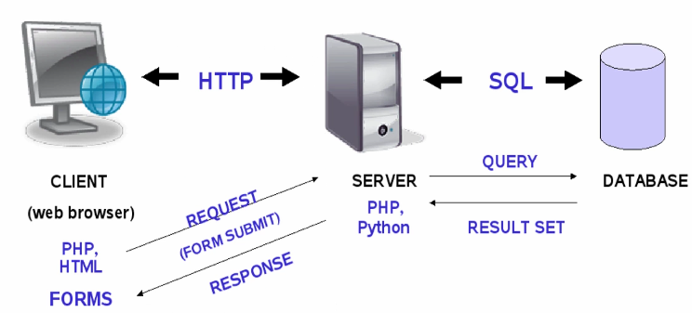
PHP and Web Server Architecture Model
PHP (Hypertext PreProcessor or Personal Home Page) is a server side scripting language.
PHP code sits on server where it is processed according to its scripted directions and the response is given to client in the form of HTML/JSON.

Slide 18
Animated example
Browser
client
Web
server
Browser sends
URL to web server,
requesting a file or
program
Fetches file or runs
server side (php) script
Apache web server
SQL commands sent
- results returned
PHP
script
Server returns results
file and/or program outputs
HTML5
CLI for PHP
and mysql
phpMyAdmin
provides separate
browser-based
interface
CSS
Browser displays
("renders") resulting page
PHP
MySQL
Database
SQL
MySQL
Javascript
Javascript - runs inside browser
jQuery AJAX - allows server connection
HTTP (developer tools)
AJAX, jQuery notation
JSON, web services
Full stack development
Integrated development
PHP – yahoo, facebook, wordpress

Slide 19
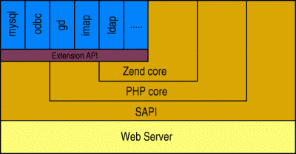
PHP Architecture
SAPI – Server API is a web server abstraction layer (provides an interface between PHP and the web server)
PHP core is the "basic" functionality provided by the language in the form of APIs.
Zend core is the engine that actually executes the PHP scripts.
Zend core includes – Zend API, Runtime compiler, extended API’s
<?php
$myvar = "Hello World!";
echo $myvar;
?>

Slide 20
PHP Functions[ Built-in and User-defined ]
<?php
function functionName() {
code to be executed;
}
?>
<?php
function addNumbers(int $a, int $b) {
return $a + $b;
}
echo addNumbers(5, "5 days");
// it will throw an error
?>
<?php
function disciplineName($name) {
echo "$name belongs to NS.<br>";
}
disciplineName("Jane");
disciplineName("Hagel");
disciplineName("Stale");
disciplineName("Jim");
?>

Slide 21
PHP Strings - A string is a sequence of characters, like "Hello world!".
strlen() - Return the Length of a String
echo strlen("Hello world!");
str_word_count() - Count Words in a String
echo str_word_count("Hello world!");
strrev() - Reverse a String
echo strrev("Hello world!");
strpos() - Search For a Text Within a String
echo strpos("Hello world!", "world");
str_replace() - Replace Text Within a String
echo str_replace("world", "Dolly", "Hello world!"); - Replace the text "world" with "Dolly"

Slide 22
Reading data from web pages (Setting up web page to communicate with PHP)
<form action=“path to submit page” method=“get”>
<!–- form contents -->
</form>
action = “…” is the page that the form should submit its data to.
method = “…” is the method by which the form data is submitted.
The option are either get or post.
If the method is get the data is passed in the url string,;
If the method is post it is passed as a separate file.
In PHP
The form variables are available to PHP in the page to which they have been submitted.
The variables are available in two superglobal arrays created by PHP called $_POST and $_GET.
$_GET and $_POST variables are used to retrieve information from forms.

Slide 23
Reading data from web pages (Access Data)
<form action=“welcome.php” method=“get”>
<input type=“text” name=“email”>
</form>
In welcome.php fetch the value in variable $email.
$email = $_GET[‘email’];
Access submitted data in the relevant array for the submission type, using the input name as a key.
PHP $_REQUEST is used to. collect data after submitting an HTML form.
$_REQUEST contains the contents of both $_GET, $_POST, and $_COOKIE.
Can be used to collect form data sent with both the GET and POST methods.

Slide 24
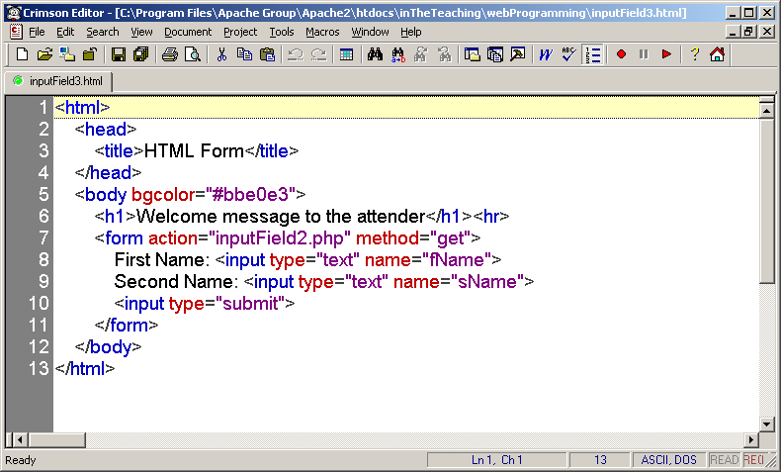

Slide 25
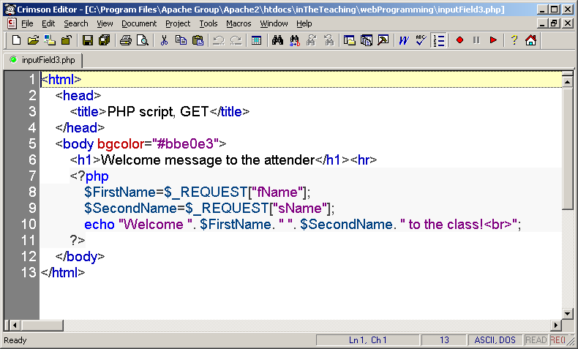

Slide 26
When to use what ?
When to use method="post"? | When to use method=“get"?
Information sent from a form with the POST method is invisible to others and has no limits on the amount of information to send. | Information sent from a form with the GET method is visible to others and has limits on the amount of information to send (max. 100 characters)
As the variables are not displayed in the URL, it is not possible to bookmark the page. | The get method passes the variables along to the “inputField2.php" web page by appending them onto the end of the URL. It is possible to bookmark the page.

Slide 27
Form Handling- using Get Method
a.html
Welcome.php
<html>
<body>
<html>
<body>
<form action="welcome.php" method=“get">
Name:
<input type="text" name="name">
<br>
<input type="submit">
</form>
Welcome
<?php
echo $_GET["name"];
?>
</body>
</html>
</body>
</html>

Slide 28
Form Handling-
Difference between get and post method
$_GET is an array of variables passed to the current script via the
URL parameters.
$_POST is an array of variables passed to the current script via the HTTP POST method.
When to use GET?
Information sent from a form with the GET method is visible to everyone. GET also has limits on the amount of information to send. The limitation is about 2000 characters.
When to use POST?
Information sent from a form with the POST method is invisible to
others and has no limits on the amount of information to send.
However, because the variables are not displayed in the URL, it is not possible to bookmark the page.

Slide 29
Form Handling- using Post Method
a.html
Welcome.php
<html>
<body>
<html>
<body>
<form action="welcome.php" method="post">
Name:
<input type="text" name="name">
<br>
<input type="submit">
</form>
Welcome
<?php
echo $_POST["name"];
?>
</body>
</html>
</body>
</html>

Slide 30
Browser Handling power (power of PHP in browsers)
Predefined Variables : These variables are used to provide information from and about the web server, the web browser, and the user. They are called superglobals.
Variable Name | Variable Description
$_GET | HTTP GET Variables
$_POST | HTTP POST Variables
$_FILES | HTTP File Upload Variables
$_SERVER | Server And Environment Information
$_COOKIE | HTTP Cookies
$_SESSION | Session Variables
$_REQUEST | HTTP Request Variables
$GLOBALS | References All Variables In A Global Scope
$php_errormsg | The Previous (Last) Error Message

Slide 31
$_SERVER
$_SERVER elements
Variable Name | Variable Description
$_SERVER['PHP_SELF'] | The filename of the currently executing script (.php file)
$_SERVER['SERVER_ADDR'] | Server IP address where the current script is executing.
$_SERVER['SERVER_NAME'] | Server host name. (If the script is running on a virtual host, this will be the value defined for that virtual host.)
$_SERVER['SERVER_SOFTWARE'] | Server identification string, given in the headers when responding to requests. (Apache)
$_SERVER['SERVER_PROTOCOL'] | Name and revision of the information protocol via which the page was requested; i.e. 'HTTP/1.0';
$_SERVER['REQUEST_METHOD'] | Which request method was used to access the page; i.e. 'GET', 'HEAD', 'POST', 'PUT'.
$_SERVER['HTTP_USER_AGENT'] | String denoting the user agent (Mozilla)

Slide 32
$_SERVER example
<?php echo “Your IP Address Is: “ $_SERVER['REMOTE_ADDR'] "<br>"; echo “The current page name Is: “ $_SERVER['PHP_SELF'] "<br>"; echo “You came from page called: “$_SERVER['HTTP_REFERER']
"<br>";
?>

Slide 33
PHP and Object Oriented Programming
Object-oriented programming (OOP) refers to the creation of reusable software object-types / classes that can be efficiently developed and easily incorporated into multiple programs.
In OOP an object represents an entity in the real world (a student, a desk, a button, a file, a text input area, a loan, a web page, a shopping cart).
An OOP program = a collection of objects that interact to solve a task / problem.

Slide 34
Why use classes and objects?
PHP is a primarily procedural language.
Small programs are easily written without adding any classes or objects.
Larger programs, however, become cluttered with so many disorganized functions.
Grouping related data and behavior into objects helps manage size and complexity.

Slide 35
File Handling (include or require file)
include | Include_once
Includes and evaluates the specified file during the execution of the script. include 'filename'; or require 'filename'; | If the code from a file has already been included, it will NOT be included again.
 | include_once may be used in cases where the same file might be included and evaluated more than once during a particular execution of a script.
 | Avoids problems such as function redefinitions, variable value reassignments, etc.
The include and require statements are identical, except upon failure:
require will produce a fatal error (E_COMPILE_ERROR) and stop the script.
include will only produce a warning (E_WARNING) and the script will continue.

Slide 36

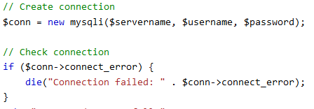
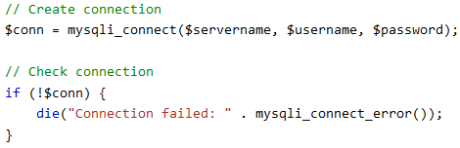
Database operations
PHP connects to databases using connection objects.
MySQLi class (improved and object oriented class for connection)
PDO (PHP Data Objects) works on 12 different database systems.
MySQLi works only with MySQL databases.
Both are object-oriented.
Additionally, MySQLi also offers a procedural API.

Slide 37
MySQL Functions PHP connects to databases using mysql_connect() or mysqli_connect;
Function | Return Value | Parameters
mysqli_connect() It opens a connection to a MySQL Server. | It returns an object representing the connection to the MySQL server | Host Specifies the host name or IP address.
 |  | Username Specifies mysqli user name.
 |  | Password Specifies mysqli user password.
 |  | DBName Specifies mysqli database.
 |  | Port Specifies the port number to attempt to connect to the MySQL server
 |  | Socket Specifies Socket name.

Slide 38
MySQL Functions
Function | Return Value | Parameters
mysqli_create_db() It opens a connection to a MySQL Server. | It returns an object representing the connection to the MySQL server | Host Specifies the host name or IP address.
 |  | Username Specifies mysqli user name.
 |  | Password Specifies mysqli user password.
 |  | DBName Specifies mysqli database.
 |  | Port Specifies the port number to attempt to connect to the MySQL server
 |  | Socket Specifies Socket name.

Slide 39
PHP & JSON
JSON is used to read data from a web server, & display it in a web page.
Objects in PHP can be converted into JSON by using the PHP function json_encode()
“phpJSON.php”
<?php $myObj->name = "John"; $myObj->age = 30; $myObj->city = “India"; $myJSON = json_encode($myObj); echo $myJSON; ?>
{"name":"John", "age":30, "city":"India"}

Slide 40
Client Javascript
Use AJAX call to request the data from PHP file
“phpJSON.html”
<html><body>
<script>
var xmlhttp = new XMLHttpRequest();
xmlhttp.onreadystatechange = function() {
if (this.readyState == 4 && this.status == 200) {
myObj = JSON.parse(this.responseText);
document.getElementById("demo").innerHTML = myObj.name;
}
};
xmlhttp.open("GET", “phpJSON.php", true);
xmlhttp.send();
</script>
</body></html>
xmlhttp.onreadystatechange= function() {
};
John

Slide 41
JSON and PHP Array
<?php $myArr = array("John", "Mary", "Peter", "Sally"); $myJSON = json_encode($myArr); echo $myJSON; ?>
["John","Mary","Peter","Sally"]
“phpJSON.html”
<html><body> <script>
var xmlhttp = new XMLHttpRequest();
xmlhttp.onreadystatechange = function() {
if (this.readyState == 4 && this.status == 200) {
myObj = JSON.parse(this.responseText);
document.getElementById("demo").innerHTML = myObj[2];
}
};
xmlhttp.open("GET", “phpJSON.php", true);
xmlhttp.send();
</script>
</body></html>
Peter

Slide 42
JSON and PHP Database
Assumption : Table containing the details of users.
Make a request to the server asking the details of first n records in the “users" table.
“phpDBJSON.html”
<html><body> <script>
var obj, dbParam, xmlhttp;
obj = { "table":“users", "limit":5 }; //1. Define an obj containing a table property and a limit value.
dbParam = JSON.stringify(obj); //2. Convert the object into a JSON string.
xmlhttp = new XMLHttpRequest();
//4. Wait until the request returns with the result (as JSON)
xmlhttp.onreadystatechange = function() {
if (this.readyState == 4 && this.status == 200) {
myObj = JSON.parse(this.responseText);
document.getElementById("demo").innerHTML = this.responseText; //5. Display result
}
};
xmlhttp.open("GET", “phpDBJSON.php?q=“+dbParam, true);
xmlhttp.send(); //3. Send a request to the PHP file, with the JSON string as a parameter.
</script>
</body></html>

Slide 43
JSON and PHP Database
“phpDBJSON.php”
<?php
header("Content-Type: application/json; charset=UTF-8"); $obj = json_decode($_GET[“q"], false); //1. Convert the request into an object $conn = mysqli_connect(“localhost", “root", “sa", “fileCorpus");
$sql = "SELECT user_name FROM ". $obj->table . " LIMIT “ . $obj->limit; $result = mysqli_query($conn, $sql);
$outp = array();
//2. Access the database, and fill an array with the requested data. $outp = $result->fetch_all(MYSQLI_ASSOC); echo json_encode($outp); //3. return the object as JSON ?>

Slide 44
JSON and PHP Database
Assumption : Table containing the details of customers, products, and suppliers.
Make a request to the server asking the details of first 10 records in the "customers" table.
“phpDBJSON.html”
<html><body> <script>
var obj, dbParam, xmlhttp, myObj, rec, result=“” ;
obj = { "table":“users", "limit":5 }; //1. Define an obj containing a table property and a limit value.
dbParam = JSON.stringify(obj); //2. Convert the object into a JSON string.
xmlhttp = new XMLHttpRequest();
//4. Wait until the request returns with the result (as JSON)
xmlhttp.onreadystatechange = function() {
if (this.readyState == 4 && this.status == 200) {
myObj = JSON.parse(this.responseText);
for ( rec in myObj ){
result+= myObj[rec].name + “<br”>;\
}
document.getElementById("demo").innerHTML = result; //5. Display result
}
};
xmlhttp.open("GET", “phpDBJSON.php?q=“+dbParam, true);
xmlhttp.send(); //3. Send a request to the PHP file, with the JSON string as a parameter.
</script>
</body></html>

Slide 45
Open a Connection to MySQL
<?php
// Create connection
$conn = new mysqli(“localhost”, “root”, “”);
//MySQLi extension (the "i" stands for improved)
// Check connection
if(!$conn){
die('Could not connect: '.mysqli_connect_error());
}
echo 'Connected successfully<br/>';
?>

Slide 46
Select Data From a MySQL Database
<?php
$conn = mysqli_connect(‘localhost’, ‘root’, ‘root’, ‘db1’);
if(!$conn){ die(mysqli_connect_error());
}
echo 'Connected successfully<br>';
$sql = 'SELECT * FROM STUD';
$rs=mysqli_query($conn, $sql);
$nrows= mysqli_num_rows($rs);

Slide 47
Select Data From a MySQL Database
if($nrows > 0){
while($row = mysqli_fetch_assoc($rs)){ echo "ID :{$row['id']} <br>";
echo echo echo
"FNAME : {$row['firstname']} <br>";
"LNAME : {$row['lastname']} <br>"; " <br>";
}
}
else { echo “ No result"; }
mysqli_close($conn);
?>

Slide 48
Assignment Title
Write a PHP script to print the data of specific user from database.
What Student have to Do:
Write a PHP Script accepting Student Roll Number, Name, Email ID, Current City and Mobile Number
Under SQL Database, Create Table with Corresponding Attribute.
Add Data in Table Manually or If Possible Via PHP application ( add Records with appropriate fields)
Once Data Added, Use Option to retrieve/ Show option to receive data from table
Data of Specific user must get display on screen

Slide 49
THANK YOU

